Slide 1
How to Become a BeiGene Supplier

Slide 2
Become a BeiGene Supplier
BeiGene is committed to advancing innovative therapies that transform patients' lives. To achieve this mission, we partner with a diverse global community of suppliers who share our commitment to operating with integrity while ensuring compliance and the highest ethical standards.
SAP Ariba Network is our chosen platform to empower and enhance collaborative sourcing activities. It provides a centralized, user-friendly, and secure environment for all aspects of the sourcing journey. Please follow the steps in this Quick Reference Guide to become a BeiGene Supplier.
SAP Business Network​ Account Registration
BeiGene Supplier Registration Questionnaire
Existing Account SAP Business Network Login Assistance

Slide 3
SAP Business Network​ Account Registration

Slide 4
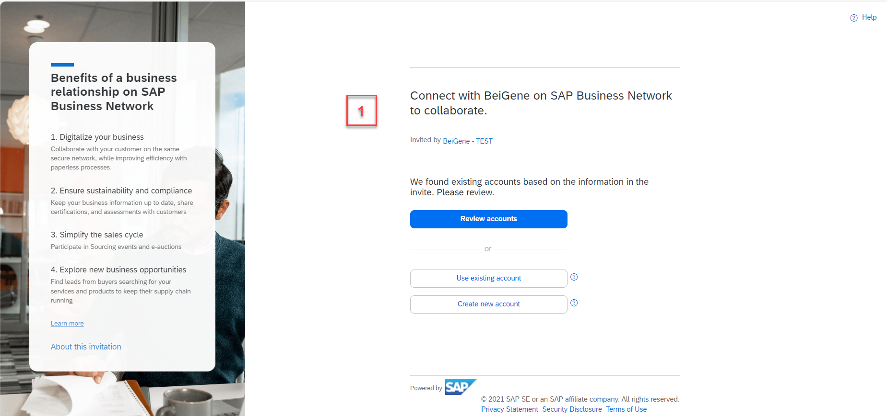
SAP Business Network Account Registration
STEP 1 - You will receive an e-mail notification with the invitation to become a BeiGene Supplier; please open the link provided. You will be redirected to the SAP Business Network log-in site.

Slide 5
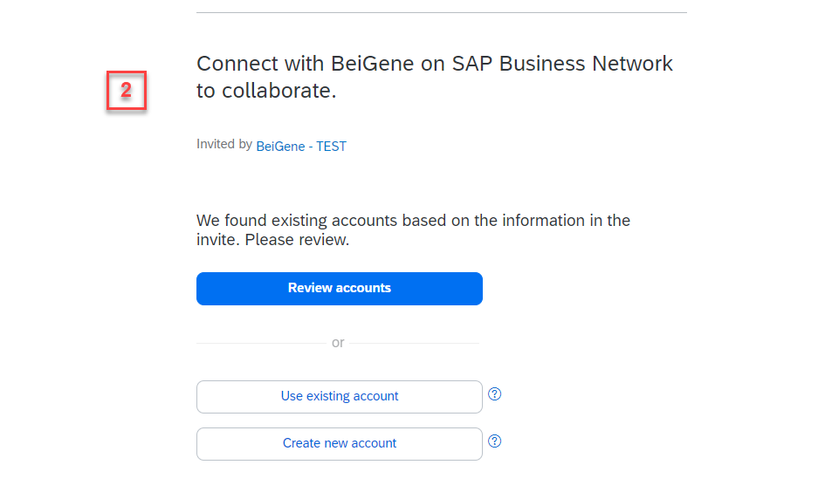
SAP Business Network Account Registration
STEP 2 - If you are new to SAP Business Network - choose Create New Account to register a new Standard Account (free of charge option).
If you are an SAP Business Network user – choose Use Existing Account and log in with the credentials of your already existing account. After this, you will be moved to the supplier questionnaire.
* If you are not sure whether your company is already using SAP Business Network, please click on Review Accounts

Slide 6
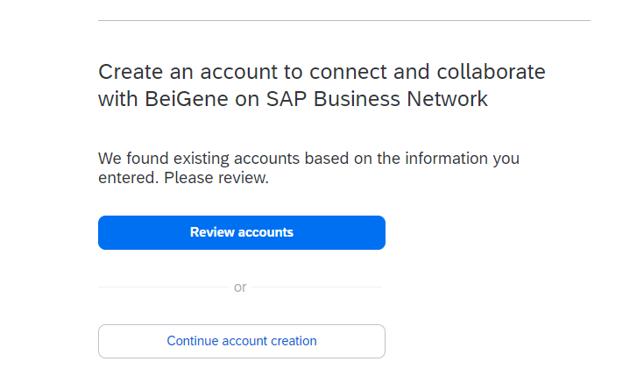
SAP Business Network Account Registration
NOTE: If you choose Create New Account to register a new Standard Account (free of charge option), you might see the message below.
* It is important to review accounts if you receive this message prior to continuing with a new account creation to avoid duplication of accounts.

Slide 7
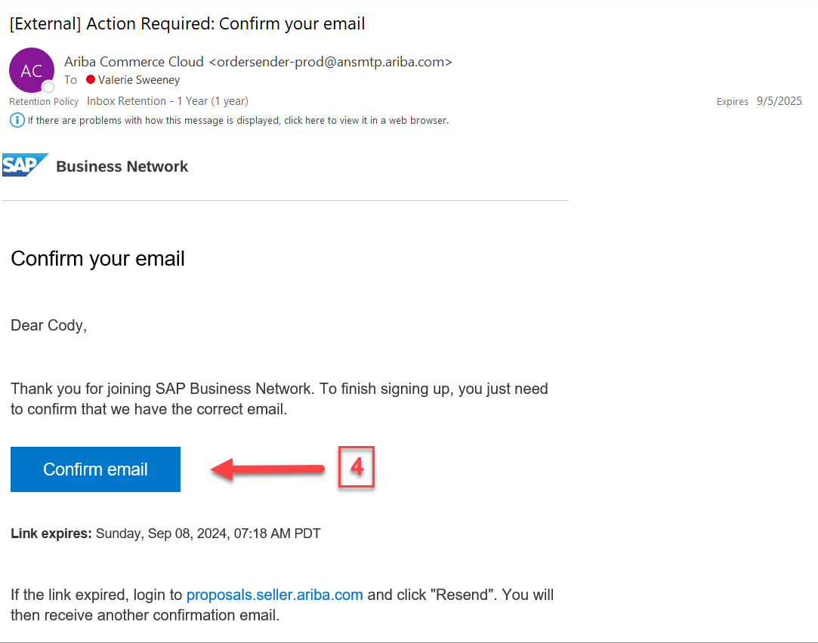
SAP Business Network Account Registration
STEP 3 – You will be prompted to confirm your email address.
STEP 4 – You will receive an email from Ariba (ordersender-prod@ansmtp.ariba.com). Click Confirm email
You must confirm your email address within 72 hours of receiving the email.
If you do not receive the email, please check your spam/junk mail folder.

Slide 8
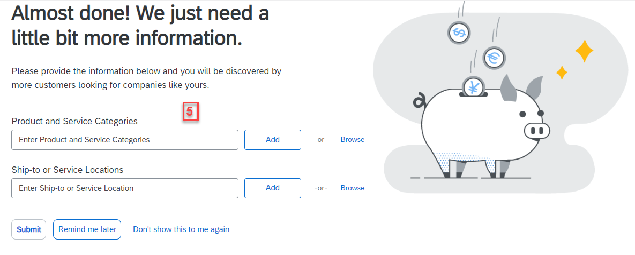
SAP Business Network Account Registration
STEP 5 – Provide information regarding your Product and Service Categories and Ship-to or Service Locations. Click on “Browse,” to select the category and location and choose the most suitable description.

Slide 9
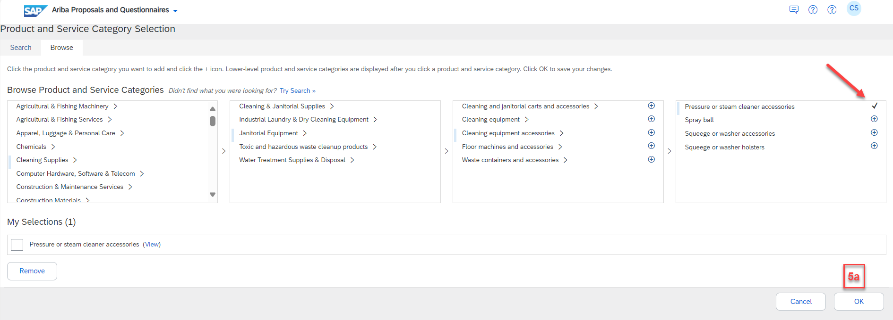
SAP Business Network Account Registration
STEP 5a. – Choose your Products and Service Categories and click OK (follow the same steps for Ship-to or Service Locations)
NOTE – If you Browse for your Products and Service Categories and Ship-to or Service Locations, you must drill down until you see a plus (+) sign to add the product or service.

Slide 10
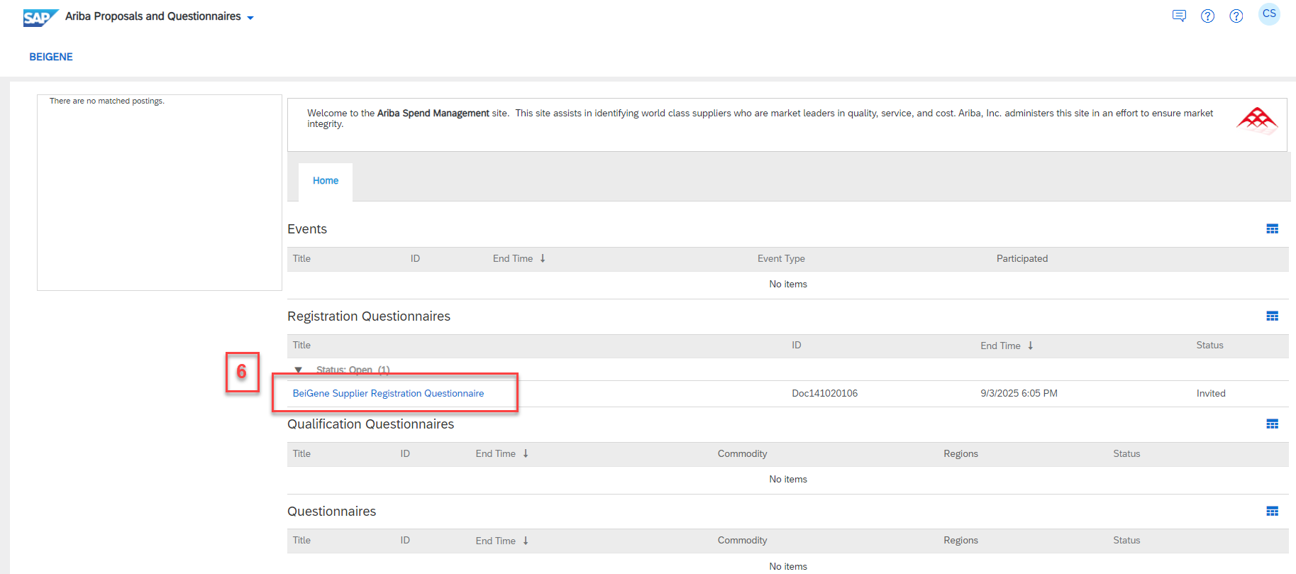
SAP Business Network Account Registration
STEP 6 – You will be directed to the Welcome page where you can complete the BeiGene Supplier Registration Questionnaire

Slide 11
BeiGene Supplier Registration Questionnaire

Slide 12
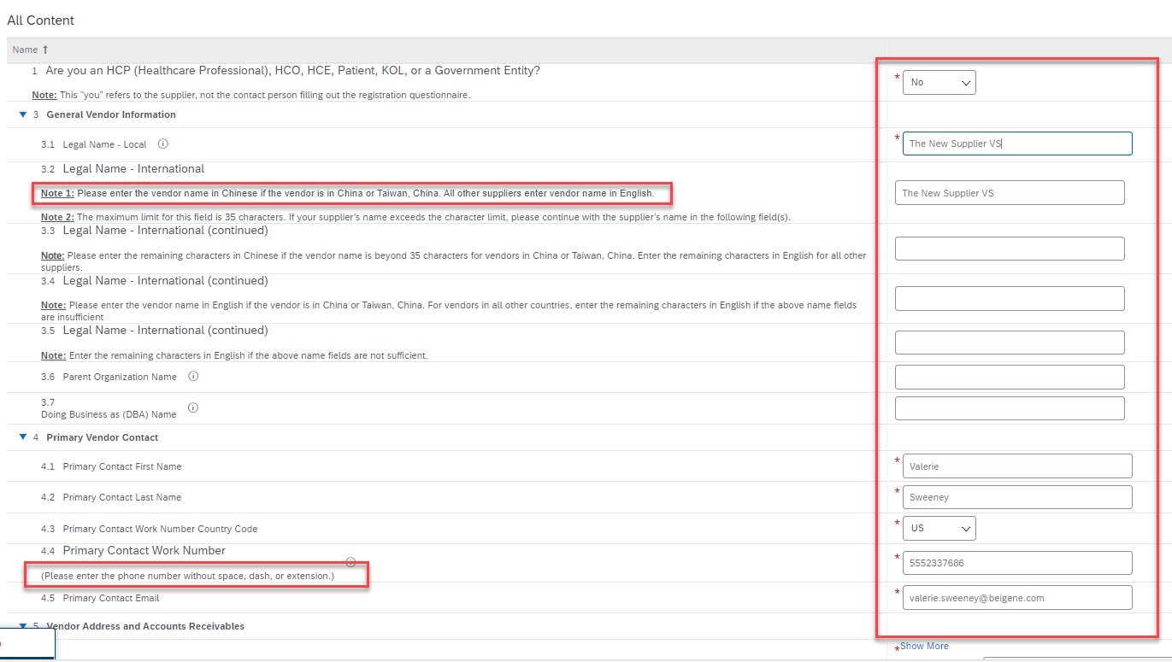
BeiGene Supplier Registration Questionnaire
STEP 1 - Complete all mandatory fields in the registration form.
** Be sure to read all
instructions to ensure
that your registration
information is processed
promptly
Please enter the phone number without space, dash,
or extension

Slide 13
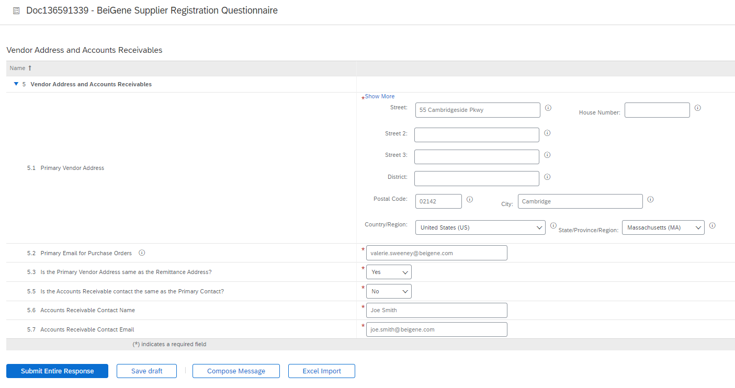
BeiGene Supplier Registration Questionnaire
STEP 2 - Vendor Address and Accounts Receivables: Please complete all required fields

Slide 14
BeiGene Supplier Registration Questionnaire
STEP 3 - Banking Information – choose Corporation or Individual for question 6.1, then click on the Add Bank Details Link
STEP 4 – Click on Add Bank Details

Slide 15
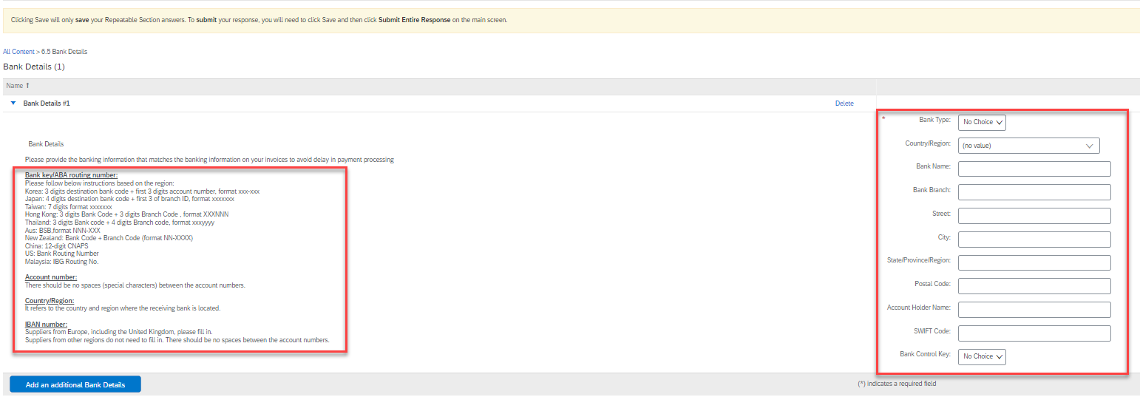
BeiGene Supplier Registration Questionnaire
STEP 5 - Please provide the banking information that matches the banking information on your invoices to avoid delay in payment processing
* Important: Please follow the guidelines with detailed instructions on how to enter bank details correctly
STEP 6 – Click on Save located on the top right side of the screen

Slide 16
BeiGene Supplier Registration Questionnaire
STEP 7 - Tax Information – provide your TAX information
STEP 8 —You must click on the links to review the Supplier Code of Conduct and BeiGene’s PO T&Cs
You are required to complete the Risk Management and Supplier Diversity Status Questionnaire

Slide 17
BeiGene Supplier Registration Questionnaire
STEP 9 - Submit your response:
Select “Submit Entire Response”. The questionnaire will be sent to BeiGene for further verification.
Tip: You can select “Save draft” to save current progress. The form will not be shared with BeiGene. You can come back later to complete and submit it.

Slide 18
Existing Account: SAP Business Network Login Assistance

Slide 19
Existing Accounts: SAP Business Network Login Assistance
If you already have an SAP Business Network account and need assistance logging into your account, please review the tips below.
Question: How do I retrieve my username?
Resolution
If you forgot your username, follow the directions below to retrieve it:
On the Supplier Login page, click Forgot Username.
Enter the email address registered to the account in the Email Address field and click Submit.
Check your email for a notification that contains a list of usernames associated with your email address.
Please note that usernames are case-sensitive.

Slide 20
Existing Accounts: SAP Business Network Login Assistance
Question: How do I reset my password as a supplier? How can I send myself a password reset?
Resolution
On the Supplier Login page, click Password.
Enter the email address registered to the account in the Email Address field and click Submit. SAP Ariba will send an email notification containing instructions on resetting your password to the email address you used to register your SAP Ariba account.
Click the link in the Password Reset notification email.
Enter and confirm your new password.
Click Submit.
Some password recommendations:
Must contain between 8 and 32 characters
Must contain at least one lowercase letter, one uppercase letter, numeric character and one special character
Special characters allowed are !#$&'()*+,-./:;<=>?@^_`{|}~\"][
Cannot contain username
It is not recommended to use repeating characters and numbers sequentially

